Slide 1
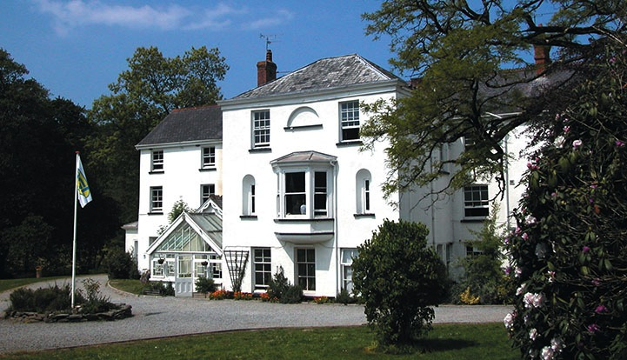
Beam House North Devon
2nd October- 4th October

Slide 2
Agenda
Welcome to PGL
Beam House – North Devon
The PGL difference
Multi-Activity
Adventure activities & evening entertainment
Accommodation & facilities
Catering and dietary needs
Health & safety
FAQs
Questions?

Slide 3
Welcome to PGL
The UK’s largest provider of outdoor education for young people
Over 55 years’ experience
Fully risk assessed
LOtC Quality Badge holder
Founding member of BAPA
ABTA bonded
Notes:
PGL provides a wide range of inspiring residential adventure and educational courses for more than 5,000 groups every year
All PGL centres and activities are risk assessed to comply with legal requirements and best practice. Risk assessments are available by request and on the PGL website
Centres are subject to the Adventure Activities Licensing Authority regulations (AALA) where appropriate
ABTA (Association of British Travel Agents) bonded means your money is protected
BAPA – British Activity Providers Association. Responsible for establishing operating guidelines for the activity holiday industry
Through the Learning Outside the Classroom Quality Badge Programme you can be confident that recognised providers fulfil all the necessary criteria as laid down by the DfE, thereby better enabling Party Leaders to manage visits safely, efficiently and beneficially

Slide 4
The PGL difference
Dedicated PGL ‘Groupie’ to provide support throughout stay
Tailor-made programmes
All accommodation, food, activities and instruction included
Free evening entertainment
24 hour support from centre team
Notes:
Each group will have a PGL Groupie who will look after guests for the duration of their stay
All accommodation, food, equipment and instruction is included in the price of the trip
Activities are chosen to suit the requirements of the group
4 x 1 ½ hour activity sessions every day
A full evening entertainment programme run by PGL staff includes discos, talent shows and quizzes

Slide 5
Health & safety
The PGL Code of Practice describes all safety and operational procedures both on and off-site including:
Sample risk assessments
Staff-to-pupil ratios
Operating procedures
Staff vetting & training
Site security
First Aid procedures
Emergency procedures
www.pgl.co.uk/cop
Notes:
Please see Code of Practice for further detail
All centres and activities are fully risk assessed every year
The PGL Code of Practice details all the control measures put in place to minimise risk
Sample risk assessments are available on line and specific assessments are available from PGL on request
Staff-to-pupil ratios comply with recognised industry standards
Operating procedures all comply with recognised industry standards and National Governing Body guidelines where these are relevant
PGL recruitment officers have extensive experience at a senior level on centre and make selections based on a detailed application form
Two formal written references are taken and applicants have to provide documentary evidence of all qualifications claimed
All offers of employment are subject to DBS checks, the successful completion of pre-employment training and a favourable probationary period
All our instructors are specifically trained for our programmes to ensure the delivery of safe and rewarding sessions across a wide range of activities
At every PGL centre there is an experienced and professional Centre Manager (supported by Senior Staff) who is in charge of centre operations and has overall responsibility for the success of the course and the performance of our staff
It is the policy of PGL to take all reasonable steps to ensure the safety and security of all guests and staff on our centres (details in Code of Practice)
Each centre has at least two First Aid staff who hold the “First Aid at Work” qualification and in addition all our instructors and group leaders complete an 8 hour first aid course. Party Leaders and teachers will ultimately remain responsible for the administration of first aid to their party members
There are rigorous general accident and emergency procedures in place
Through the Quality Badge Programme you can be confident that recognised providers fulfil all the necessary criteria as laid down by the DfE, thereby better enabling Party Leaders to manage visits safely, efficiently and beneficially

Slide 6
LEARNING OUTSIDE
Beam House – North Devon
25 fantastic adventure activities to choose from
Close to the beach and surf school at Westward Ho!
Beautiful location with great hiking opportunities
Close to Devon’s coast-to-coast cycle path, the Tarka Trail

Slide 7
Multi-Activity
4 action-packed adventure activity sessions per day
Evening entertainment
Great for personal development & confidence building
Increases motivation & appetite for learning
Notes:
Benefits of a multi-activity course include:
- improved self confidence
- improved team-building skills
- better peer group relationships
- raised self esteem
- increased motivation.

Slide 8
Adventure activities
Abseiling
Aeroball
Archery
Blokarting
Bodyboarding
Challenge Course
Climbing
Coastal Walk
Fencing
First Aid
High Ropes Course
Kite Flying
Mountain Biking
Orienteering
Problem Solving
Quad Biking
Rifle Shooting
Sensory Trail
Sports and Team Games
Street Surfing
Surfing
Survivor
Trapeze
Zip Wire
Notes:
The activities shown offer individual as well as team challenges
Activities are designed to encourage new skills and develop existing ones
Specific activities can be requested (though not guaranteed) and the programme is discussed on arrival at the centre

Slide 9
Evening entertainment
Ambush
Campfire
Capture the Flag
Cluedo
Disco
Passport to the World
Quiz
Robot Wars
Splash
Wacky Races

Slide 10
Accommodation
Main House – rooms with bunk beds sleep 6-16
Toilets and showers close by
Notes:
The centre can accommodate 156 guests at a time with accommodation in the main house
Teachers are usually accommodated in twin or triple rooms with en suite and hot drink facilities
All rooms are lockable (party leader given master key)
All exterior doors and gates are locked at night but can be opened from the inside in an emergency without the need for unlocking
A PGL staff member is available on duty throughout the night (contactable by phone)
The extensive facilities (other than activity bases) are available to your group during free time

Slide 11
Catering and dietary needs
3 nutritious, balanced meals per day
Self-service salad bar
Vegetarian option
Special diets catered for by prior arrangement
Sample menus available online: www.pgl.co.uk
Notes:
We continually invest in healthy menus with freshly cooked ingredients obtained from fully traceable audited suppliers
Processed food is avoided and meals meet Local Authority guidelines
There will be hot and cold options available at every meal
At lunch and dinner the buffet includes a salad bar and mixed fruit basket plus hot and cold drinks
Our caterers can deal with most dietary requirements but please ensure the party leader is aware of any dietary requirements well in advance
More food is always available if required

Slide 12
FAQs
Insurance
What to take – kit list
Valuable items – best left at home
Pocket money – how much to take
Electrical appliances – must be safe
Deodorants – roll-on only please
Contacting your child
Notes:
PGL includes extensive insurance cover organised through travel insurance specialists (see separate insurance details)
Please limit luggage to one case/bag per person and one item of hand luggage for carrying food etc. on the journey
The kit list is provided on the Parent Pupil Information Leaflets however we would like to stress that:
Old, casual clothes are recommended
Pack more clothes if it is likely to be wet weather
All clothing should be marked with the student’s name and school
Brand new and expensive items (such as mobile phones) should be left at home
Pocket money - It is very much up to you. As a guide, a figure of £5.00 - £10.00 per day would be reasonable
Electrical appliances - Guests are responsible for the safety of any electrical appliances brought to centre. The Centre Manager reserves the right to ask for appliances not to be used if they appear to be unsafe
Deodorants - It is advised that children bring roll-on deodorants rather than aerosol deodorants as these can often set off fire alarms
Laundry facilities - There are limited laundry facilities on centre and therefore they can only be used in an emergency
Contacting your child - Parents are asked not to call the centre except in an emergency. The centre telephones are business lines and may be needed for emergencies

Slide 13
Thank you for listening
Any questions?
Notes:
Questions?

